Slide 1
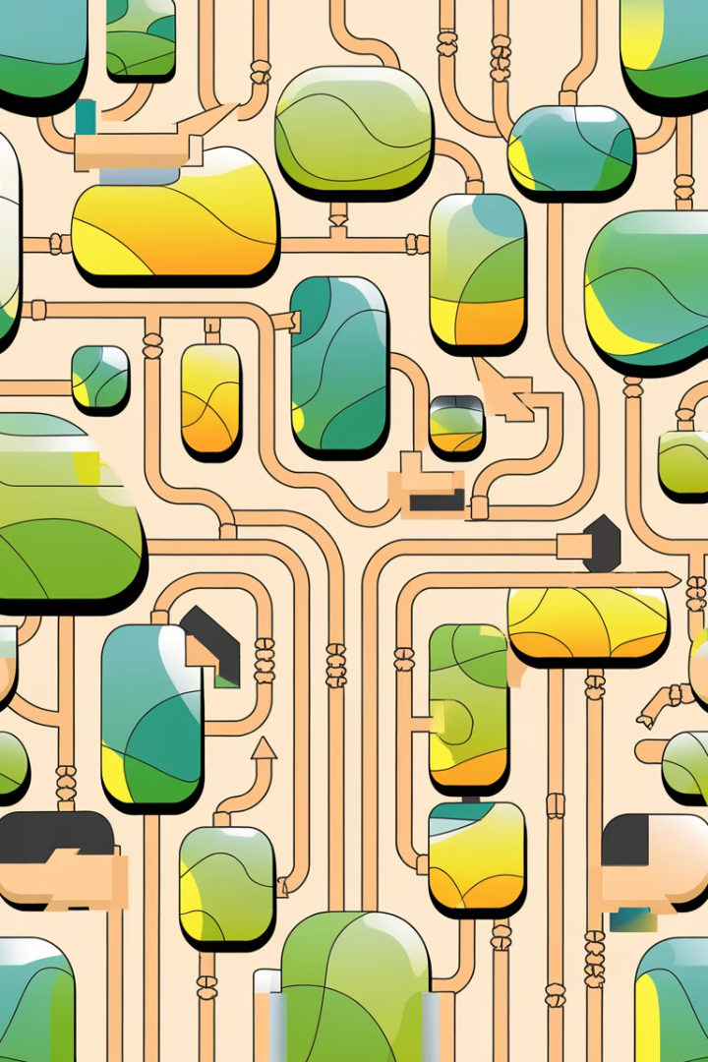
From Fully Connected Layers to Convolution
Explore the transition from traditional fully connected neural network layers to the powerful technique of convolutional layers, which revolutionized image processing and computer vision.

Slide 2
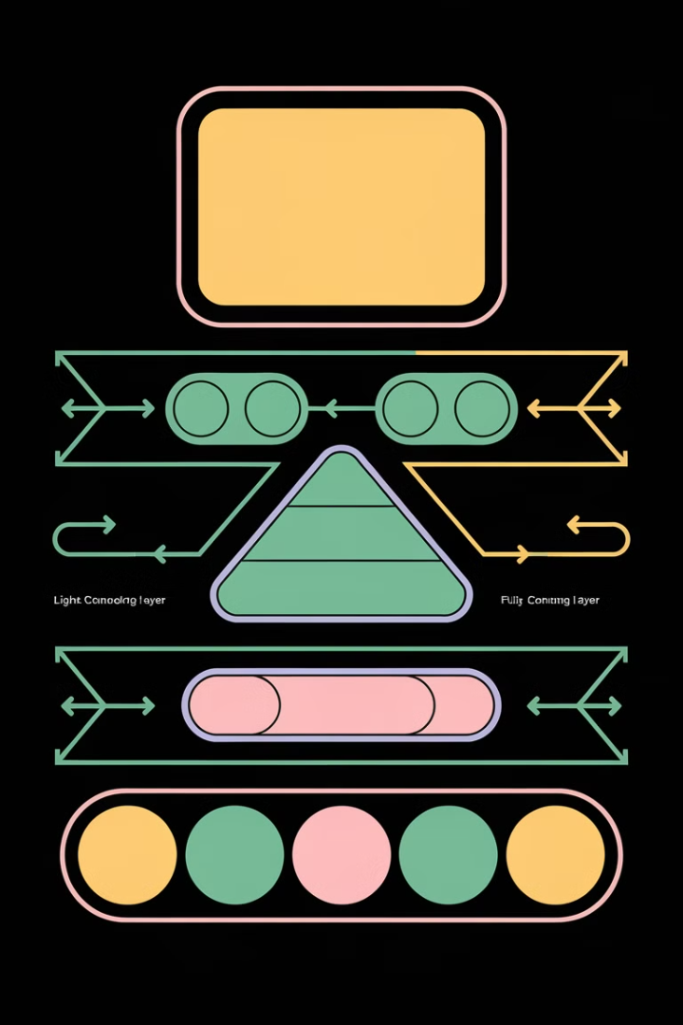
Introduction to Convolutional Neural Networks
Convolutional Neural Networks (CNNs) are a specialized type of neural network designed for processing grid-like data, such as images. They leverage the inherent spatial structure of images to learn efficient feature representations, enabling powerful computer vision capabilities.

Slide 3
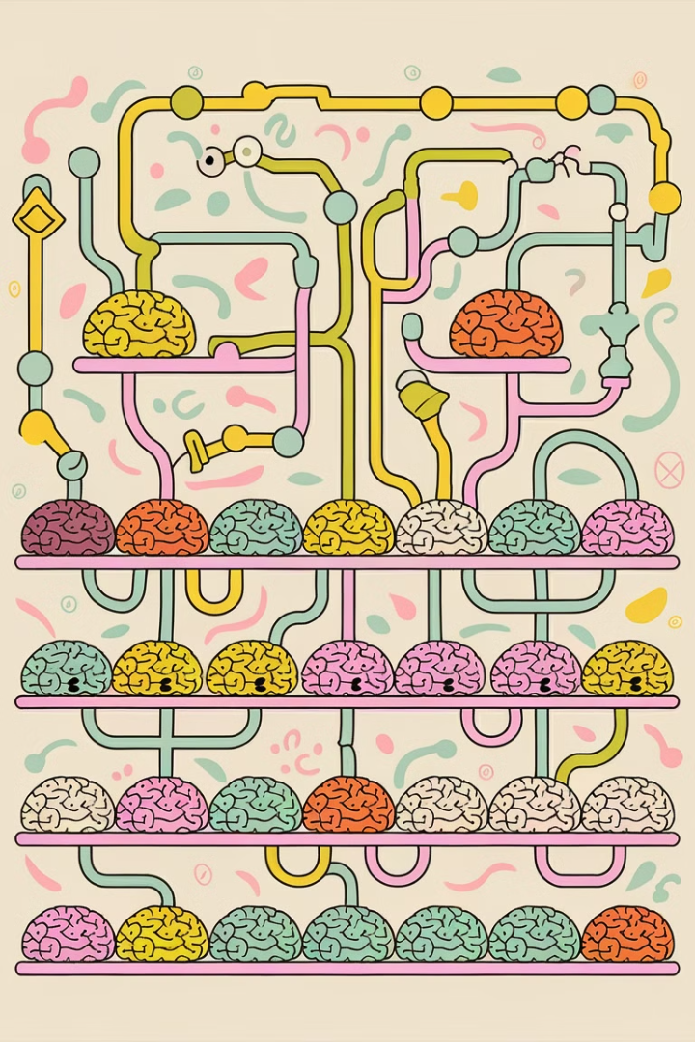



What are Fully Connected Layers?
Interconnectivity
In a fully connected layer, every neuron in the layer is connected to every neuron in the previous layer.
Grid-Like Structure
Fully connected layers do not preserve the spatial structure of the input data, treating it as a flat vector.
Learning Features
Fully connected layers can learn complex, high-level features from the preceding convolutional and pooling layers.

Slide 4
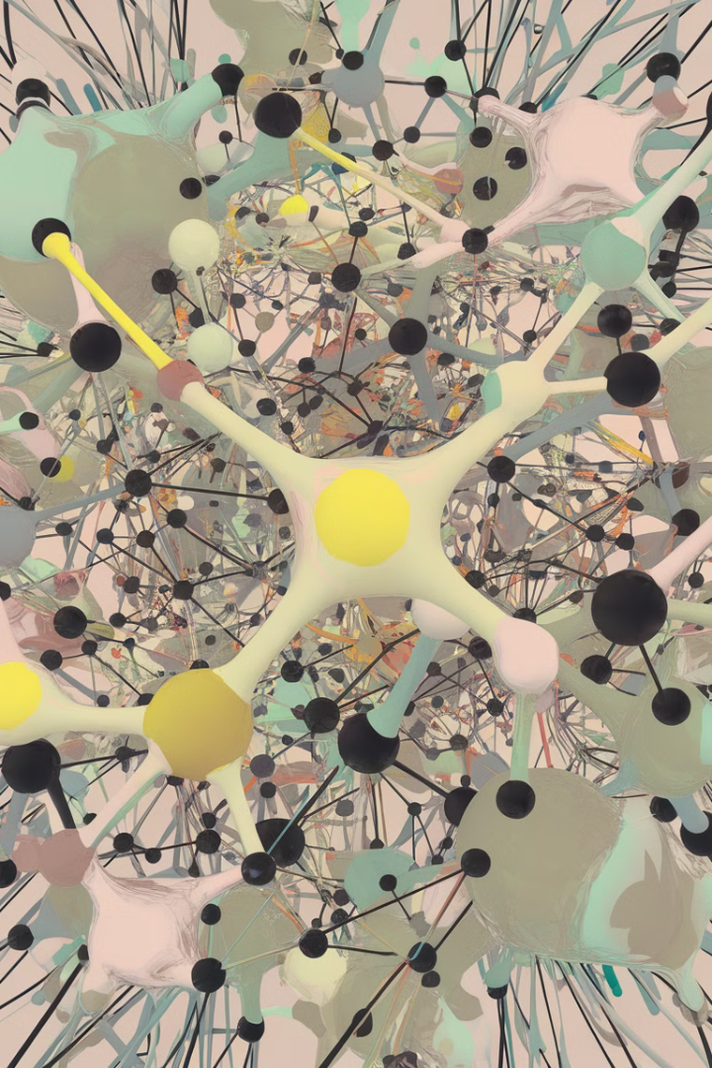
Limitations of Fully Connected Layers
High Model Complexity
Inability to Capture Spatial Relationships
Fully connected layers have a large number of parameters, making the model complex and prone to overfitting.
Fully connected layers do not consider the spatial structure of the input, like the relative positions of pixels in an image.
Inefficient Feature Extraction
Fully connected layers struggle to effectively extract and reuse relevant visual features from the input.

Slide 5

Introducing Image Convolution
Convolution is a fundamental operation in convolutional neural networks (CNNs) that allows the model to learn local patterns and features in images. It involves sliding a small filter or kernel over the input image, performing an element-wise multiplication, and summing the results to produce a new feature map.
This local connectivity and weight sharing enable CNNs to effectively extract hierarchical features from images, making them powerful for tasks like image classification, object detection, and segmentation.

Slide 6
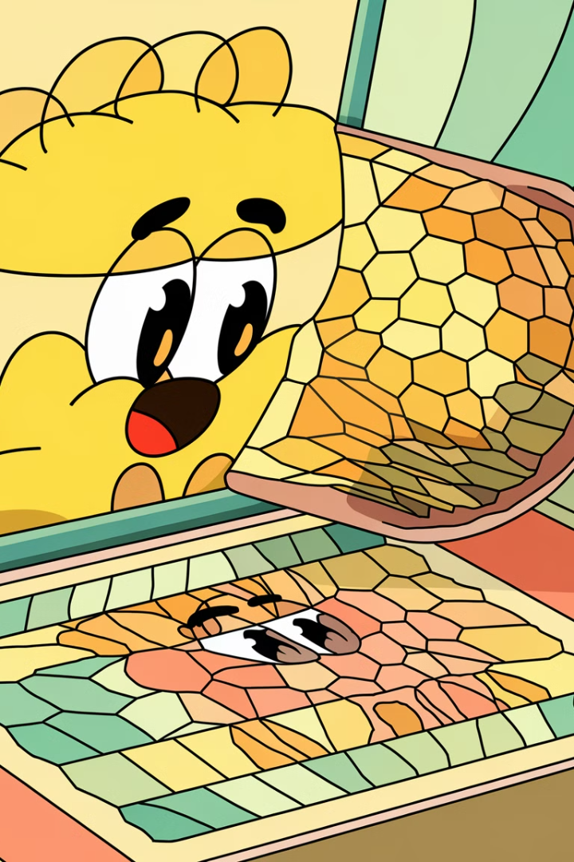




The Convolution Operation
Input Image
The convolution operation starts with an input image, which is a 2D array of pixel values.
Convolution Kernel
A small 2D matrix, known as the convolution kernel or filter, is then moved across the input image.
Element-wise Multiplication
At each position, the kernel is element-wise multiplied with the corresponding region of the input image.
Summation
The resulting products are then summed to produce a single output value, which is placed in the output feature map.

Slide 7

Receptive Fields and Local Connectivity
Receptive Fields
Local Connectivity
The receptive field refers to the region in the input that a particular neuron or feature detector in a neural network is sensitive to.
In convolutional layers, each neuron is only connected to a local region in the previous layer, unlike fully connected layers where each neuron is connected to all neurons in the previous layer.
Hierarchical Features
This local connectivity allows convolutional networks to learn a hierarchy of features, from low-level patterns to high-level concepts, as the data propagates through the layers.

Slide 8
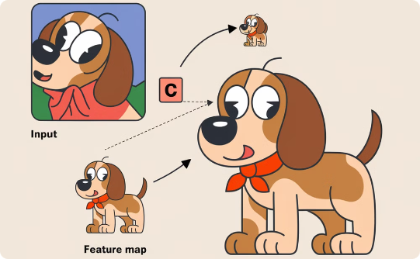

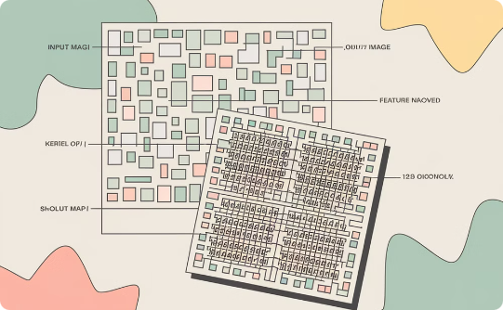
Padding in Convolution
Zero Padding
Valid Padding
Same Padding
Padding the input image with a border of zeros allows the convolution to be applied at the edges, preserving the original image size in the output.
Applying the convolution kernel only where it fits completely within the input image results in a smaller output feature map, discarding the edge pixels.
Padding the input with zeros to produce an output feature map of the same spatial dimensions as the input allows the full image to be preserved.

Slide 9
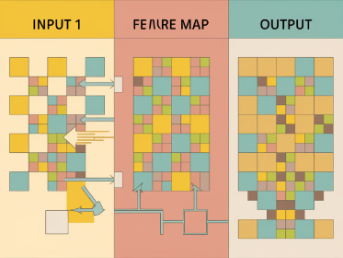
Stride in Convolution
Adjusting Convolution Window
Reducing Spatial Dimensions
Overlap and Receptive Fields
Increasing the stride value will decrease the spatial dimensions of the output, reducing the number of computed features. This can be useful for downsampling and managing computational complexity.
With a stride greater than 1, the convolution window will not fully overlap, leading to non-contiguous receptive fields in the output. This can affect the model's ability to capture spatial relationships.
The stride parameter in convolution allows us to control the step size of the convolution window as it moves across the input image. This lets us adjust the spatial resolution of the output feature map.

Slide 10
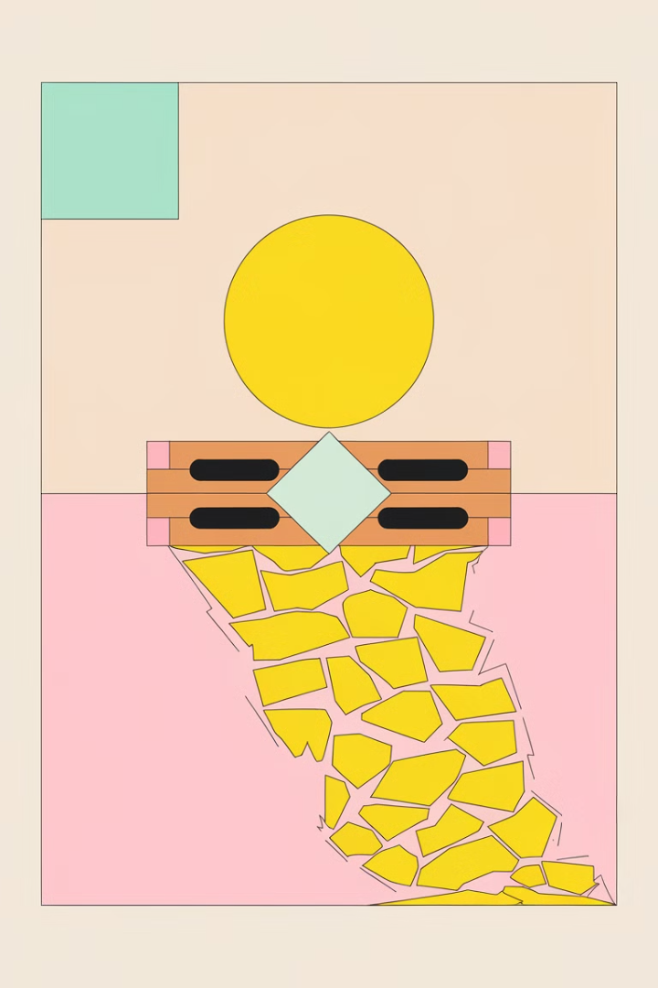
Visualizing Convolution
Visualizing the convolution operation helps us understand how it works. The convolution filter slides across the input image, performing element-wise multiplication and summation to produce the output feature map. This process captures local patterns and features in the image.
The size and stride of the filter, as well as the padding applied, all affect the resulting feature map. Visualizing these parameters in action provides intuition about how convolutional layers extract meaningful representations from raw image data.

Slide 11




Multi-Input and Multi-Output Channels
Multiple Input Channels
Convolutional networks can accept input with multiple channels, such as the three color channels (RGB) of an image.
Multiple Output Channels
The convolutional layers can also produce multiple output channels, which can represent different learned features.
Connecting Channels
Each output channel is connected to a subset of the input channels, allowing the network to learn specialized feature detectors.

Slide 12
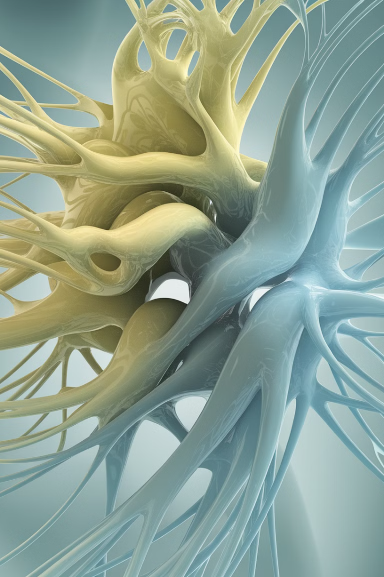
Motivations for Multiple Channels
Richer Feature Representations
Specialization and Modularity
Multiple channels allow the model to learn a diverse set of low-level visual features, capturing more information from the input image.
Different channels can become specialized for detecting specific types of patterns, enabling a more modular and flexible architecture.
Increased Modeling Capacity
Stacking multiple channels exponentially increases the number of learnable parameters, allowing the model to represent more complex functions.

Slide 13
Stacking Channels in the Input
Grayscale Image
1
Single channel input
RGB Image
2
Three channels for red, green, blue
Multi-Channel Inputs
3
Stacking multiple feature maps as input
Convolutional neural networks typically take multi-channel input data, such as RGB images with three color channels. The ability to stack multiple feature maps as input allows the network to learn patterns across these different channels, capturing more complex visual representations.

Slide 14

Stacking Channels in the Output
1
Multiple Output Channels
Convolutional neural networks can produce multiple output feature maps, with each channel representing a different type of visual pattern.
2
Channel Stacking
The output channels are stacked together to form a multi-dimensional feature representation, capturing a diverse set of visual concepts.
3
Hierarchical Feature Extraction
Higher layers in the network can combine these output channels to learn more complex and abstract visual features.

Slide 15
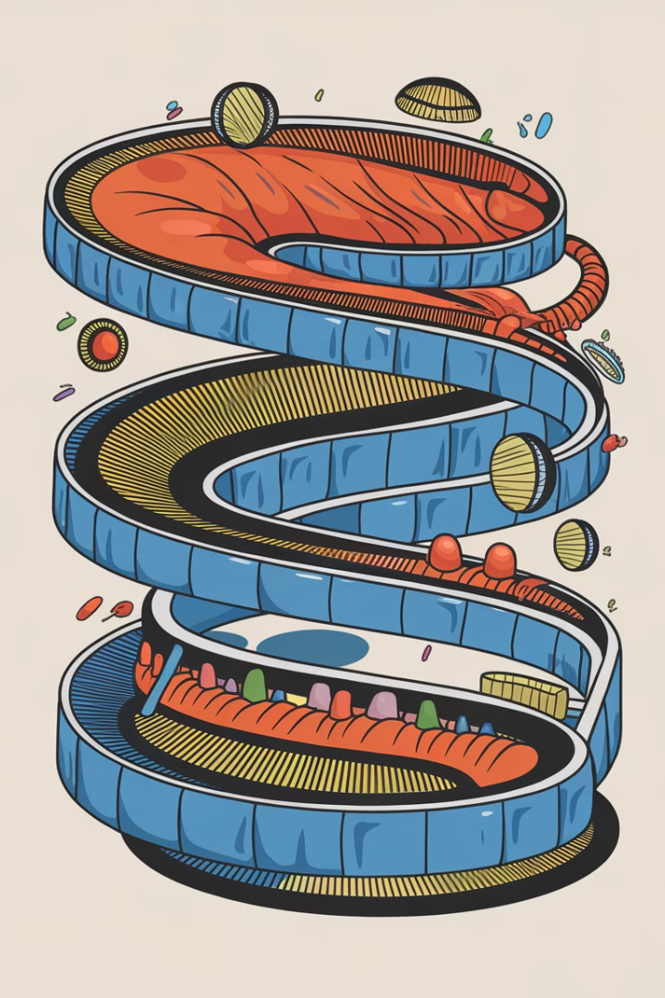
Pooling Layers
Pooling layers are a key component of convolutional neural networks, used to progressively reduce the spatial dimensions of the feature maps while retaining the most important information.

Slide 16
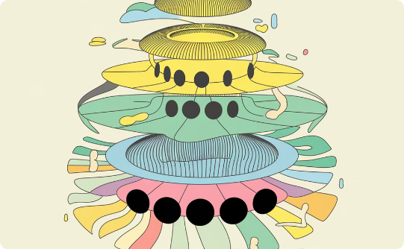
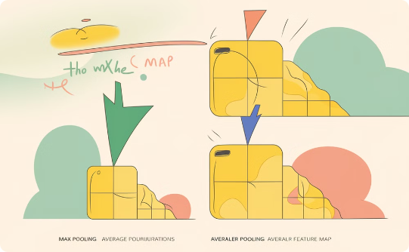
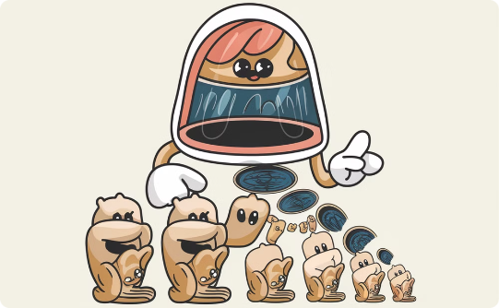
The Purpose of Pooling
Dimensionality Reduction
Extracting Dominant Features
Introducing Invariance
Pooling layers help reduce the spatial dimensions of the feature maps, making the network more computationally efficient and less prone to overfitting.
Pooling layers make the network more robust to small translations, rotations, and deformations in the input, a key property for image recognition tasks.
Pooling operations like max pooling and average pooling help extract the most salient features from the convolved feature maps.

Slide 17
Max Pooling and Average Pooling
Max Pooling
Average Pooling
Max pooling selects the maximum value within a specified spatial region, capturing the most prominent features. This helps reduce the spatial dimensions of the feature maps while preserving important information.
Average pooling calculates the average value within a spatial region, providing a more balanced representation of the features. This can help smooth out the feature maps and capture more contextual information.

Slide 18
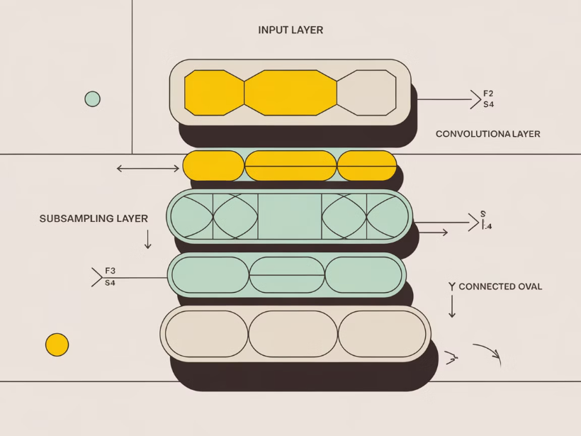
The LeNet Architecture
The LeNet architecture, developed by Yann LeCun in the 1990s, is considered one of the pioneering convolutional neural network models. It was designed for handwritten digit recognition and consisted of a series of convolutional, pooling, and fully connected layers.
The key components of LeNet include convolutional layers to extract local features, pooling layers to downsample and aggregate information, and fully connected layers to perform final classification.

Slide 19
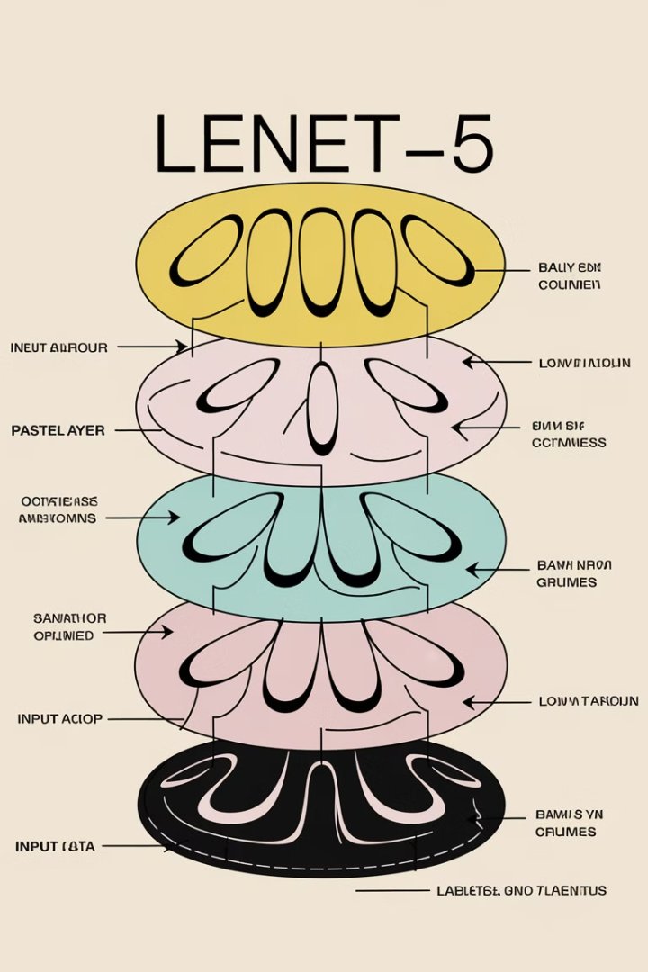
Convolutional Layers in LeNet
1
Multiple Convolutional Layers
2
Feature Maps and Receptive Fields
The LeNet architecture features multiple convolutional layers, allowing it to extract increasingly complex visual features from the input images.
Each convolutional layer outputs a set of feature maps, where each map represents the response of a specific learned filter applied to the input.
3
Gradually Increasing Complexity
The convolutional layers progressively increase the complexity of the learned features, from simple edge detectors to more abstract shape and object representations.

Slide 20
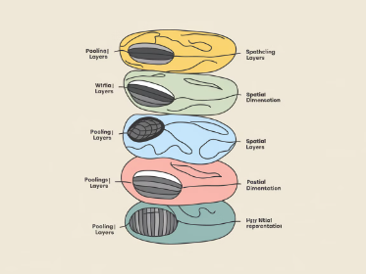
Pooling Layers in LeNet
Purpose of Pooling
Max Pooling
Spatial Downscaling
LeNet uses max pooling, which selects the maximum value from a local region of the feature map, capturing the most salient features.
Pooling layers in LeNet reduce the spatial dimensions of the feature maps, helping to make the representations more compact and invariant to small translations.
The pooling layers in LeNet downsample the feature maps by a factor of 2, reducing the number of parameters and computations in the network.

Slide 21
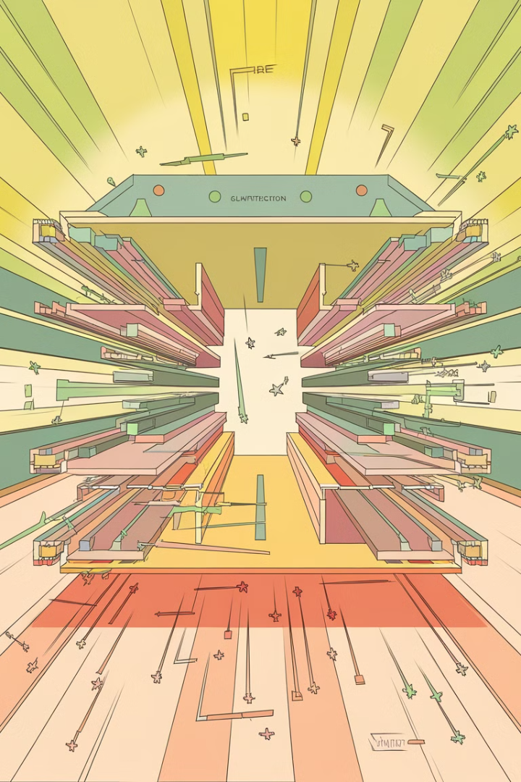
Fully Connected Layers in LeNet
1
Classification Layer
2
Flattening the Tensor
The final layers of LeNet are fully connected, taking the high-level features from the convolutional and pooling layers and mapping them to class probabilities.
The output of the last pooling layer is flattened into a 1D vector to be fed into the fully connected layers.
3
Weights and Biases
4
Non-Linear Activation
The fully connected layers have learnable weights and biases that are trained to map the feature representations to the final class outputs.
Typically, a non-linear activation function like ReLU is applied after each fully connected layer to introduce non-linearity.

Slide 22
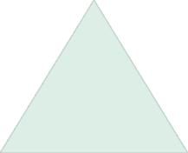



The LeNet Training Process
Labeled Data
1
Collect a large dataset of handwritten digit images with their corresponding labels.
2
Forward Propagation
Feed the input images through the LeNet architecture to generate predictions.
3
Backpropagation
Compute the loss between predictions and true labels, then update the model weights.
Optimization
4
Repeat forward and backward passes, adjusting the model to minimize the loss.
The LeNet training process involves iteratively updating the model parameters to minimize the error on a labeled dataset of handwritten digit images. This is done through cycles of forward propagation, loss computation, and backpropagation to update the weights.

Slide 23




Advantages of Convolutional Layers
Sparse Interactions
Parameter Sharing
Equivariant Representations
Hierarchical Feature Extraction
Convolutional layers share parameters across different spatial locations, which further reduces the number of parameters and allows the model to learn more efficiently.
Convolutional layers have sparse connectivity, where each output unit is connected to only a local region of the input. This reduces the number of parameters and allows for more efficient learning.
Convolutional layers produce feature maps that are equivariant to translation, meaning that a translation in the input leads to a corresponding translation in the feature map.
Convolutional networks can learn a hierarchy of features, starting from low-level patterns and building up to higher-level, more abstract representations, which is well-suited for many visual tasks.

Slide 24
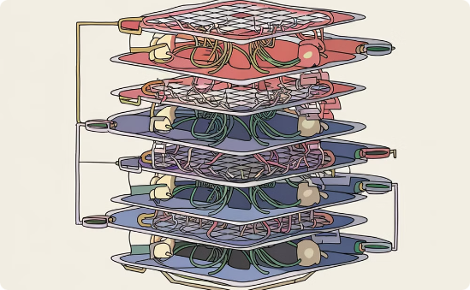
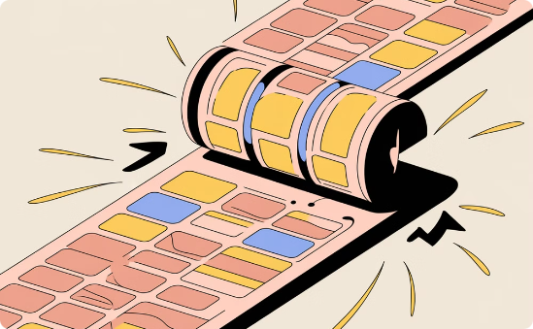
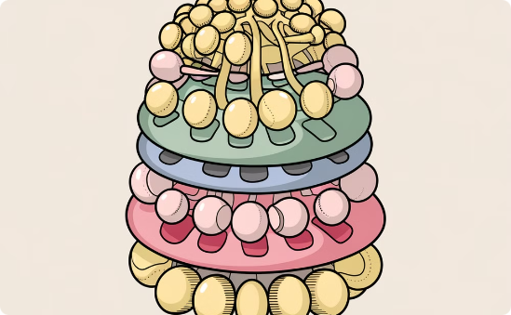
Sparse Interactions and Parameter Sharing
Sparse Interactions
Parameter Sharing
Hierarchical Feature Extraction
In convolutional layers, each neuron only interacts with a small local region of the input, unlike fully connected layers where each neuron is connected to all inputs. This sparse connectivity leads to more efficient computation.
Convolutional layers use the same set of parameters (weights and biases) for all spatial locations in the input. This parameter sharing allows the network to detect the same features regardless of their position, greatly reducing the number of parameters.
The combination of sparse interactions and parameter sharing enables convolutional networks to efficiently extract a hierarchy of features, from low-level patterns to high-level semantics, as the depth of the network increases.

Slide 25

Equivariant Representations
Preserving Spatial Relationships
Hierarchical Feature Learning
Invariance to Transformations
Convolutional networks produce feature maps that are equivariant to translations - features at different spatial locations are represented in a consistent way.
The convolutional structure allows the network to build up complex features from simpler ones, creating a hierarchical representation of the input.
Pooling layers introduce a degree of invariance to small translations, rotations, and deformations, making the network robust to common image transformations.

Slide 26
Hierarchical Feature Extraction
Building Blocks of Vision
Deeper Layers, Richer Representations
Mimicking Human Vision
Adaptable to Task
The hierarchical feature extraction allows convolutional networks to be versatile and applicable to a wide range of visual tasks, from object detection to image segmentation.
Convolutional neural networks excel at extracting visual features in a hierarchical manner. They start by detecting low-level patterns like edges and shapes, then combine these into higher-level features that represent more complex concepts.
This mimics how the human visual system processes information, where simple features are combined into more complex patterns that the brain can recognize and classify.
As the network goes deeper, the features become more and more abstract, allowing the model to understand high-level semantic information about the input image.

Slide 27

Applications of Convolutional Networks
Convolutional neural networks have revolutionized numerous domains, from computer vision to natural language processing. These powerful models excel at tasks like object detection, image classification, and even generative modeling.

Slide 28
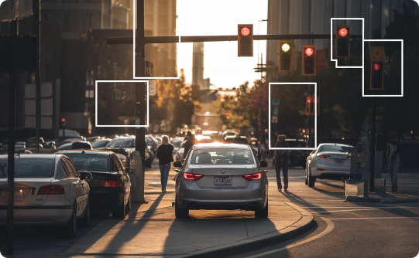


Object Detection and Segmentation
Real-Time Object Detection
Semantic Segmentation
Instance Segmentation
Advanced deep learning models can go beyond simple object detection to perform pixel-level segmentation, classifying each element of an image into semantic categories for in-depth scene understanding.
Instance segmentation takes segmentation a step further by separating and outlining individual objects, even within a dense group, enabling applications like people counting and tracking.
Convolutional neural networks can rapidly identify and locate multiple objects within an image, highlighting them with precise bounding boxes for applications like autonomous driving, surveillance, and robotics.

Slide 29





Image Classification
Precise Categorization
Granular Analysis
Convolutional neural networks excel at assigning images to specific classes with high accuracy.
Models can identify and distinguish between fine-grained visual details and subtle differences.
Real-Time Performance
Diverse Applications
From facial recognition to medical diagnosis, image classification has a wide range of practical uses.
Image classification can be performed rapidly, allowing for fast decision-making and response times.

Slide 30

Generative Models
Synthetic Data Generation
Enhancing Datasets
Generative models can be used to augment existing datasets by generating additional synthetic samples, increasing the diversity and size of the training data.
Generative models can create new, realistic-looking data such as images, text, or audio by learning the underlying patterns and distributions in the training data.
Creative Applications
Simulation and Modeling
Generative models enable novel applications like art synthesis, music composition, and procedural content generation, expanding the creative potential of AI systems.
Generative models can be used to simulate complex systems and scenarios, enabling applications in fields like physics, biology, and robotics.

Slide 31

Conclusion and Key Takeaways
In this presentation, we've explored the transition from fully connected layers to convolutional neural networks, highlighting the advantages of convolutional architectures in computer vision tasks. The key takeaways include the power of local connectivity, parameter sharing, equivariant representations, and hierarchical feature extraction.

